Slide 1
HAND GESTURE LANGUAGE RECOGNITION
S. KRISHNA PRIYA
K. SUHASINI
KAKA MAHESH

Slide 2
PROBLEM STATEMENT
In day-to-day life, computers are becoming a norm. But there are people who are not educated enough to use them. For them using computers even for the basic of requirements is a mountainous task. Also there are specially challenged people who are only know to interact with sign language from their childhood and cannot understand alphabets on the keyboard.
This project is a stepping stone to overcome the problems faced by some unfortunate citizens so they can interact with computers at railway station and hence can use as easily as we do.

Slide 3
GOAL
The goal of this project is to recognize the signs and symbols shown by people so the application or the device installed at a railway station can understand as what is conveyed and hence book the tickets to given destination in provided class.
This project recognizes 7 kinds of signs that are most commonly used in daily basis. The user shows up his/her hand depicting a symbol and the application in which the following project would be deployed will recognize the word and will process accordingly.
A graphical user interface authorizing the initialization of the application is to be developed for necessary security purposes.

Slide 4
APPROACH
Almost 12000 train images and 8000 validation images were collected and categorized so as to train the model efficiently adapting to different ways of showing up hands using Video Capture in OpenCV library.
A model was built and the images were fed into the model and trained.
At the end, when the hand is shown depicting a particular sign or symbol in front of the webcam, the system will predict as to what the user is trying to convey in real time.

Slide 5
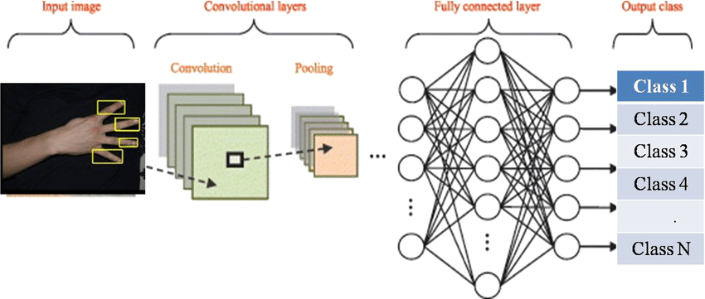
CNN ArCHITECTURE :

Slide 6
HAND GESTURE LANGUAGE RECOGNITION MODEL
The hand gesture language recognition model in this project is based on Convolution Neural Network.
CNN is a specialized type of neural network model designed for working with two-dimensional image data. They can also be used with 1-D and 3-D data.
CNN uses convolution technique i.e. multiplies an array of input data with 2-D array of weights also called as filter or kernel. We can add as many as filters we want based on our requirement.
After getting the dot product between filter and input, we then take the maximum or average of values in the resultant matrix. As a result, the input image is broken down into number of small layers.
The last step involves flattening which is nothing but making the array of numbers into 1-D to be fed into the neural network model.
With each epoch of the neural network, this whole process of CNN undergoes.

Slide 7
CHALLENGES FACED
For the Image Recognition to work efficiently, the model needs to be trained very well adapting to different conditions. As a result, hand images were captured from all the angles which will result in an efficient prediction.
Background becomes an important factor in image recognition as a change in background will result in the system interpreting an entire different image. Due to this, all images are blurred and thresholds are applied to them so as to eliminate the effect of color from the images resulting in lesser effect of the background.

Slide 8
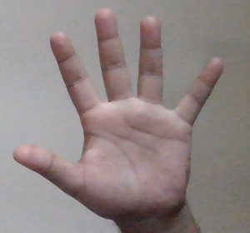
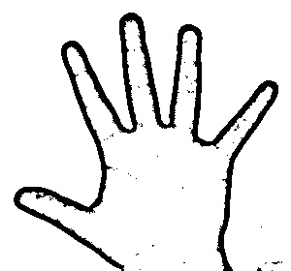
IMAGE COMPARISON between original and image after blurring and applying threshold
ORIGINAL
AFTER PROCESSING

Slide 9
UNSOLVED CHALLENGES
The effect of background still remains an issue with the project. Reducing this effect has been tried very hard by blurring the background and eliminating colors which has helped in near efficient prediction. But removing the effect completely is still needed to achieve. Too much noisy backgrounds can trigger inaccurate predictions.

Slide 10
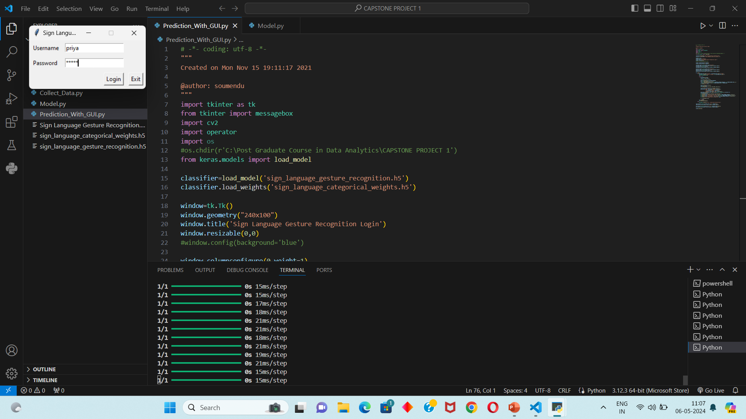
MODEL PERFORMANCE

Slide 11
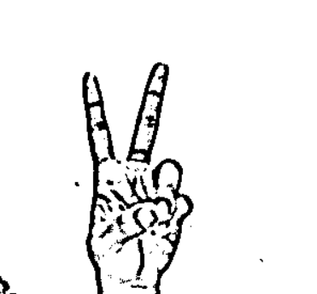
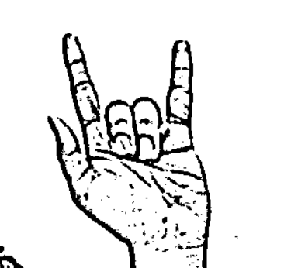
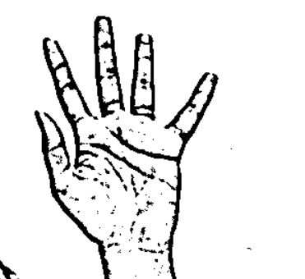
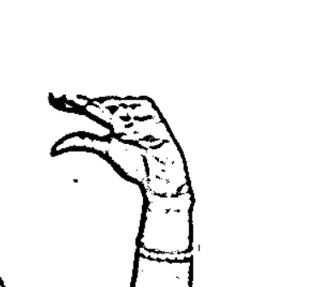
MODEL TRAINING :

Slide 12
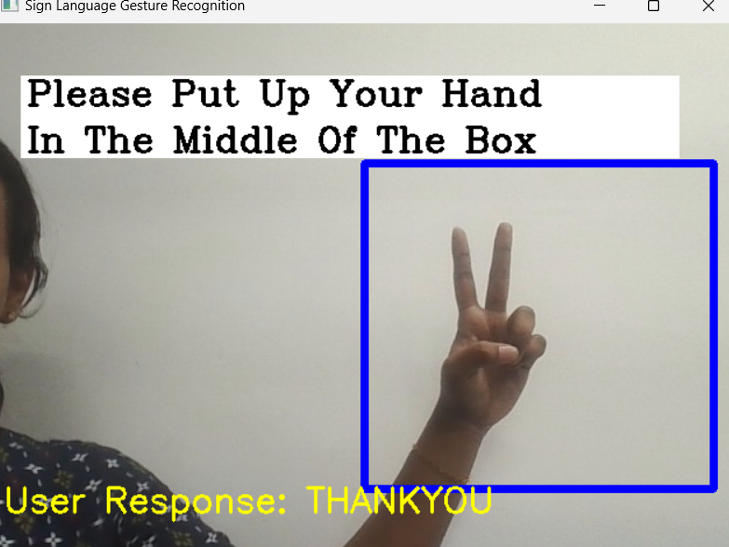
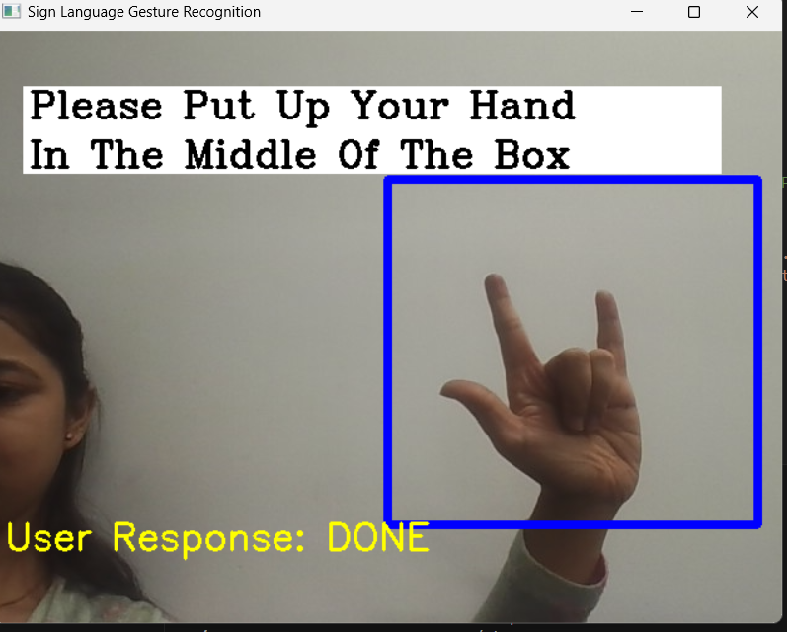
OUTPUT :

Slide 13
BUSINESS APPLICATIONS
Users can use sign language to easily control or communicate with devices without physically touching them.
Virtual Meetings: Incorporate hand gesture recognition into video conferencing software, allowing users to control presentations or navigate slides with gestures, enhancing the remote meeting experience
Healthcare: Develop a system for healthcare professionals to control medical equipment or access patient records hands-free through gesture commands, improving efficiency and hygiene in clinical settings.
Certain version of the model can also be applied in personal computers at a basic level. So that until a person learns how to operate computers normally, the application using this model can help for the basic operations like opening a folder, typing, making spreadsheets etc.

